Slide 1
Docker for Data Science
Practical Data Science Meetup
October 2018

Slide 2

We Are Hiring - Data Scientists and Analysts
We are hiring for the following positions:
Data Scientist (Immediate Start)
Data Science Intern (Spring/Summer 2019)
Data Analyst (Immediate Start)
Data Analyst (Spring 2019)
Data Analyst Intern (Spring/Summer 2019)
Go to https://www.golucid.co/careers and select Analytics

Slide 3
Typical Data
Science Workflow

Slide 4
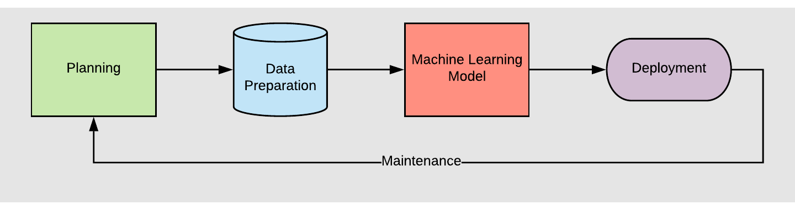
A Typical Data Science Workflow

Slide 5
A Typical Data Science Workflow
Most meetups and academic or online courses in machine learning and data science prepare you well in these areas

Slide 6
A Typical Data Science Workflow
New data scientists have much less experience in these areas of data science

Slide 7
A Typical Data Science Workflow
Today we’re going to do a deeper dive into this part: deployment

Slide 8
Model Deployment

Slide 9
Model Deployment
Many ways to deploy models. Depends on the type of model, format of expected output, schedule, etc.

Slide 10
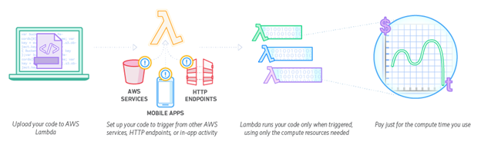
Model Deployment
Many ways to deploy models. Depends on the type of model, format of expected output, schedule, etc.
API endpoint: used for triggered machine learning model, e.g. template recommendations or support ticket routing; typically served via an AWS Lambda

Slide 11
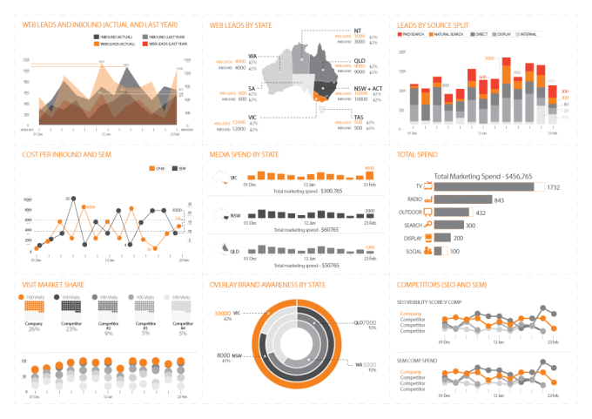
Model Deployment
Many ways to deploy models. Depends on the type of model, format of expected output, schedule, etc.
API endpoint: used for triggered machine learning model, e.g. template recommendations or support ticket routing; typically served via an AWS Lambda
Dashboard: Tableau dashboard for serving up tables or graphs, e.g. account scoring model for sales representatives or support rep productivity tracking

Slide 12
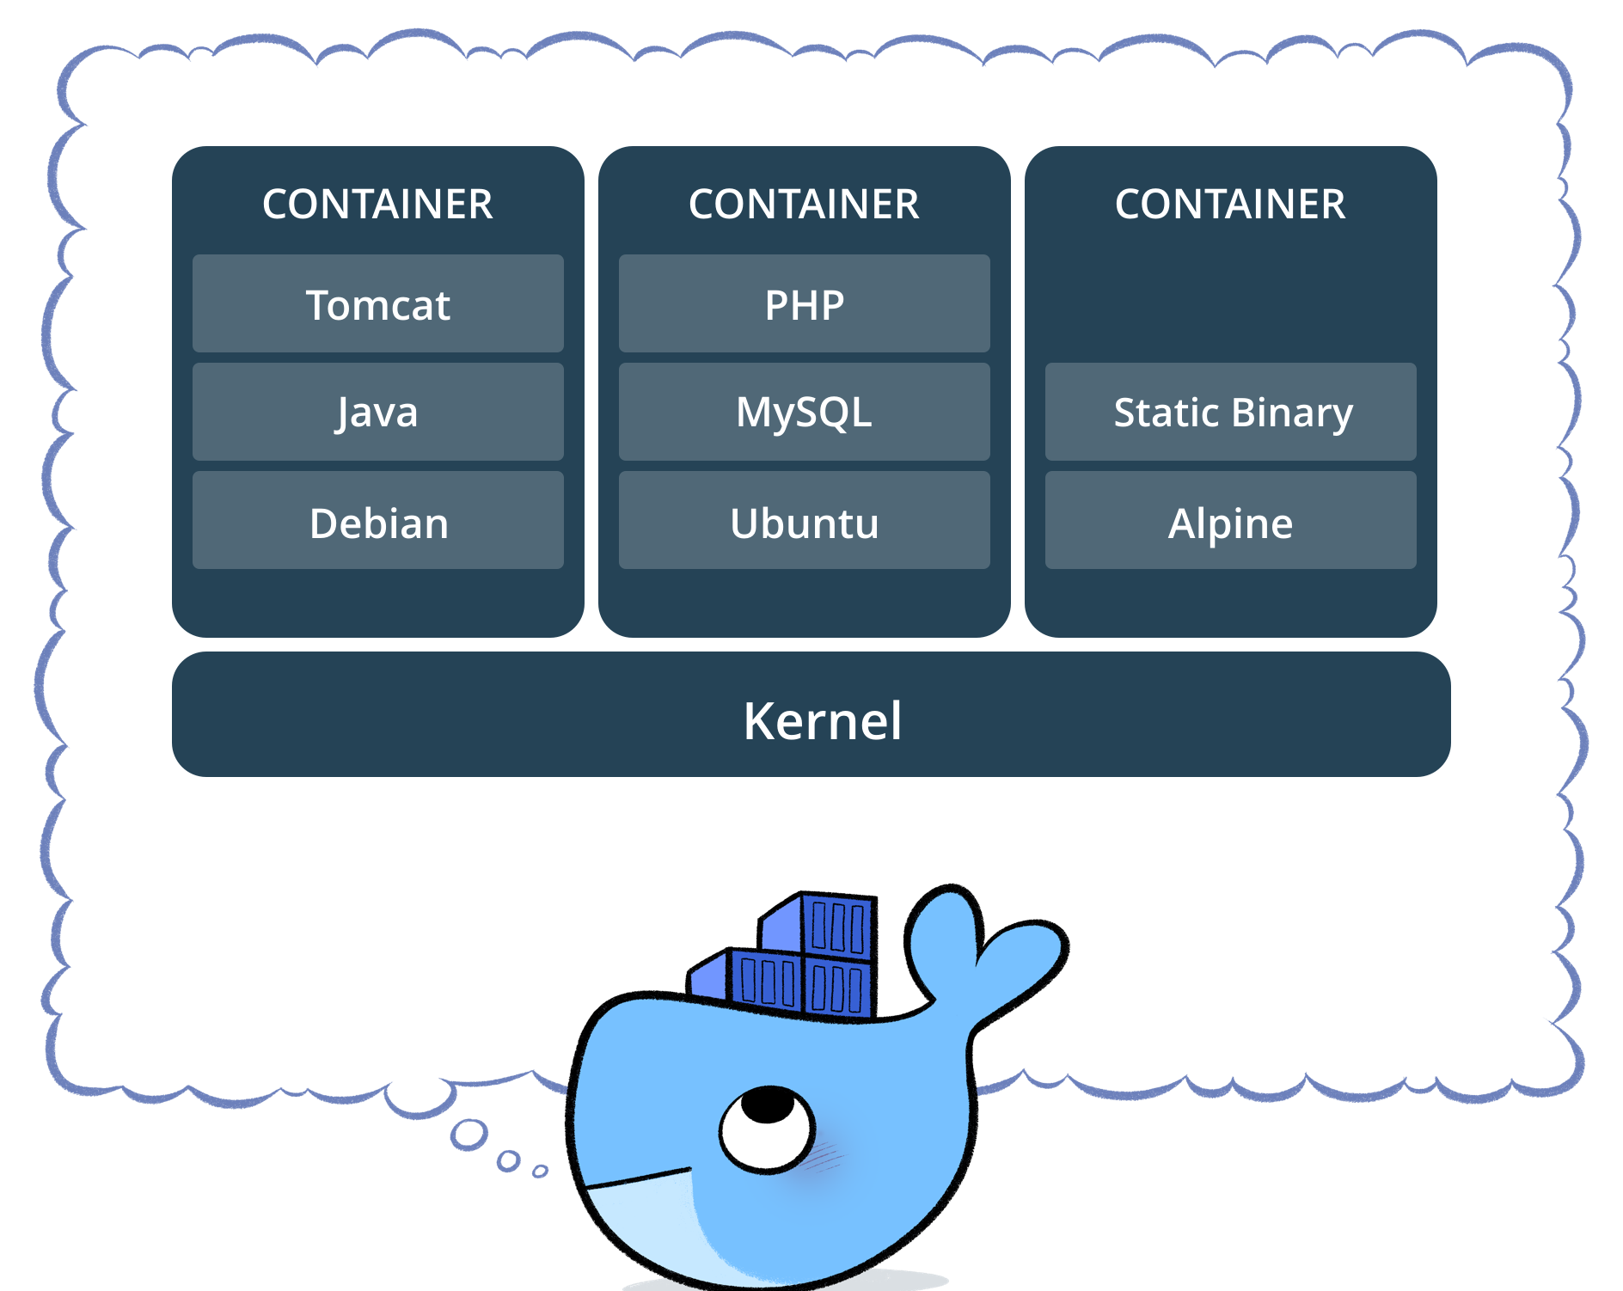
Model Deployment
Many ways to deploy models. Depends on the type of model, format of expected output, schedule, etc.
API endpoint: used for triggered machine learning model, e.g. template recommendations or support ticket routing; typically served via an AWS Lambda
Dashboard: Tableau dashboard for serving up tables or graphs, e.g. account scoring model for sales representatives or support rep productivity tracking
Simple web application or custom models: Docker used for serving web apps, in-house Flask apps, or other custom models

Slide 13
Docker Overview

Slide 14
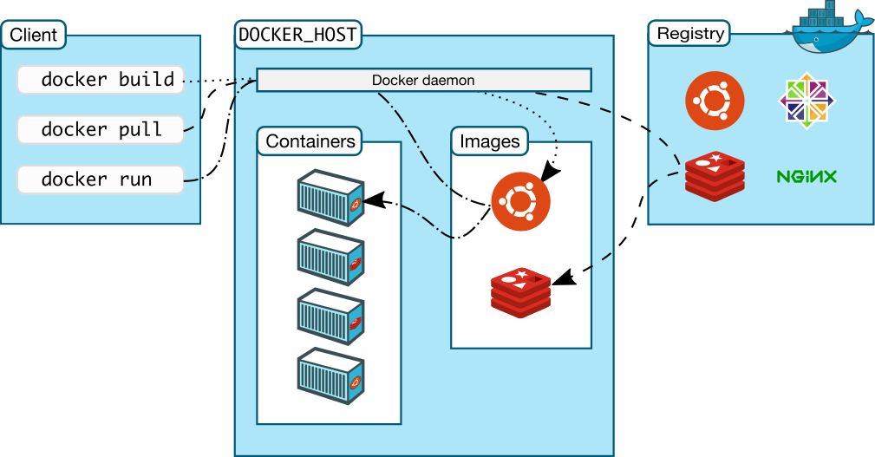
Docker Architecture

Slide 15
Docker Uses and Alternatives
Docker is important for:
Creating distinct environments for each model or app
Version control of various libraries, to ensure the model doesn’t break

Slide 16
Docker Uses and Alternatives
Docker is important for:
Creating distinct environments for each model or app
Version control of various libraries, to ensure the model doesn’t break
Similar to virtual machine, but Docker has the benefit of being able to:
Share many of the system resources with the host
Run multiple copies of the same images without linear growth in resource usage by sharing the OS kernel

Slide 17
Docker Uses and Alternatives
Docker is important for:
Creating distinct environments for each model or app
Version control of various libraries, to ensure the model doesn’t break
Similar to virtual machine, but Docker has the benefit of being able to:
Share many of the system resources with the host
Run multiple copies of the same images without linear growth in resource usage by sharing the OS kernel
Similar to python’s virtual environment, except:
Docker is not limited to just python

Slide 18
Docker Uses and Alternatives
Docker is important for:
Creating distinct environments for each model or app
Version control of various libraries, to ensure the model doesn’t break
Similar to virtual machine, but Docker has the benefit of being able to:
Share many of the system resources with the host
Run multiple copies of the same images without linear growth in resource usage by sharing the OS kernel
Similar to python’s virtual environment, except:
Docker is not limited to just python
There are many other alternatives to Docker, but Docker is popular and well-documented

Slide 19
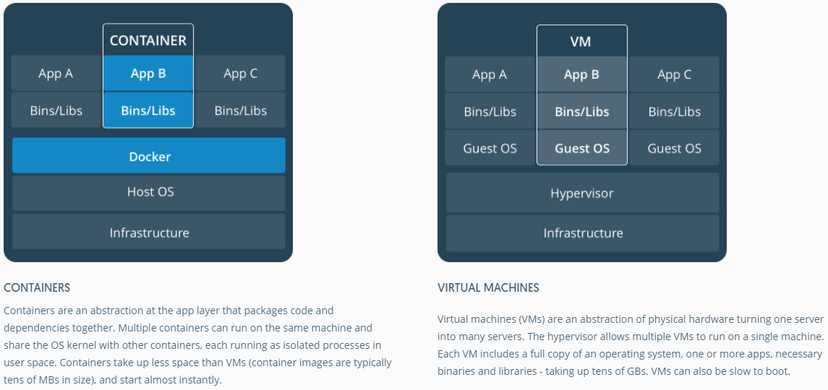
Docker Uses and Alternatives

Slide 20
Build Process

Slide 21
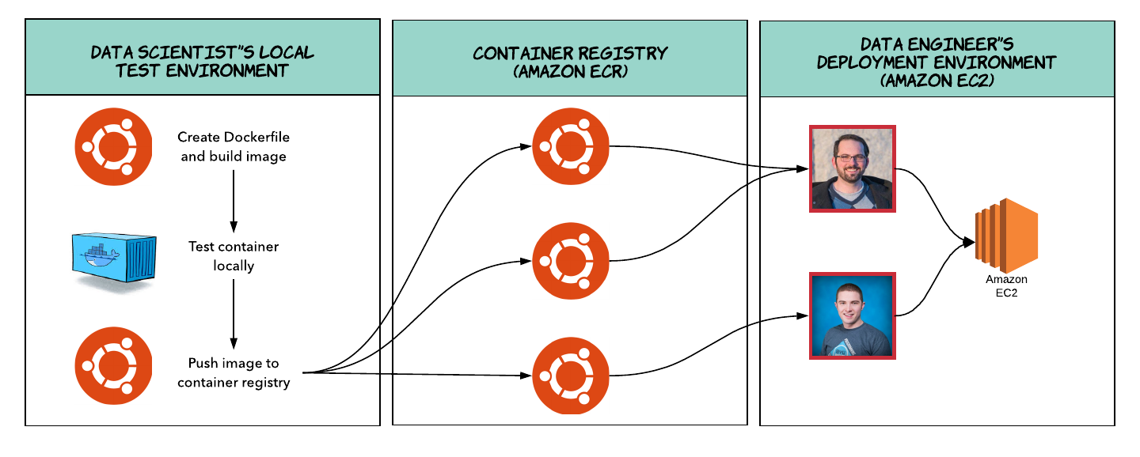
Current Deployment Process

Slide 22
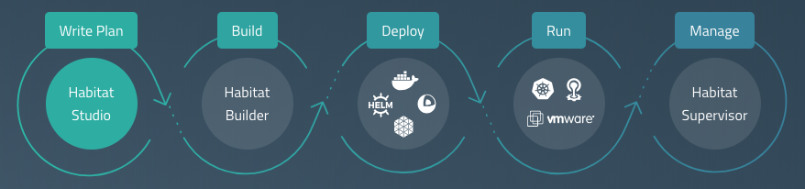
Automating Deployment Process
Working to streamline the build process by evaluating build tools such as habitat.sh. Kubernetes (EKS), Jenkins, etc.

Slide 23
Docker Example

Slide 24
Example Dockerfile - Simple Flask Apps
FROM ubuntu:16.04
MAINTAINER Vasu Chetty "vasuc@lucidchart.com"
RUN apt-get update -y
RUN apt-get install -y python-pip python-dev build-essential
WORKDIR /home/ubuntu/
COPY requirements.txt requirements.txt
RUN pip install -r requirements.txt
EXPOSE 5000
CMD ["python", "/home/ubuntu/data-science/docker-containers/anomaly-detection/run.py"]

Slide 25
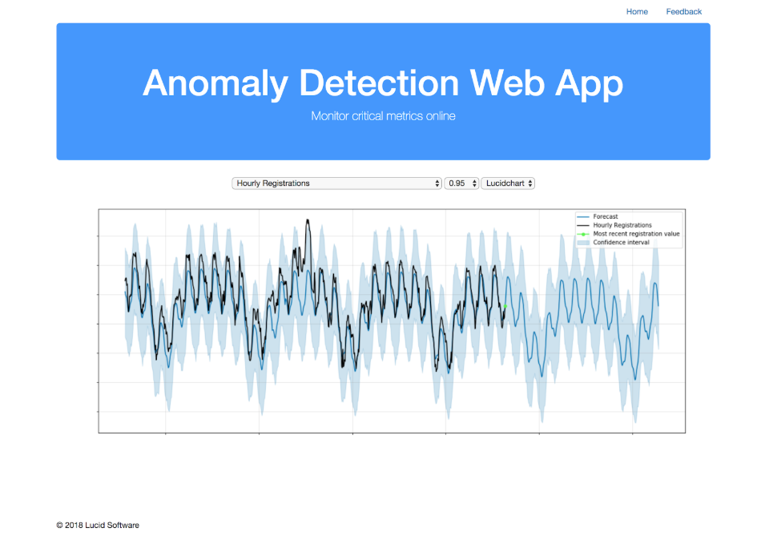
Anomaly Detection App

Slide 26
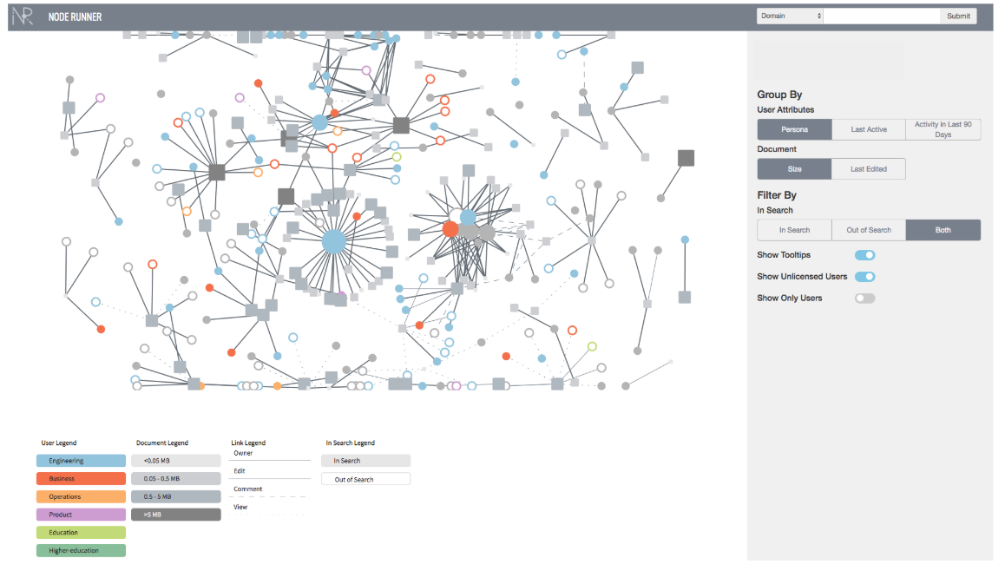
Node Runner App

Slide 27
Example Dockerfile - Knowledge Repo
FROM ubuntu:16.04
MAINTAINER Vasu Chetty "vasuc@lucidchart.com"
RUN apt-get update -y
RUN apt-get install -y python-pip python-dev build-essential
COPY requirements.txt requirements.txt
RUN pip install -r requirements.txt
WORKDIR /home/ubuntu/
RUN mkdir knowledge
WORKDIR /home/ubuntu/knowledge/
COPY .knowledge_repo_config.yml .knowledge_repo_config.yml
EXPOSE 5000
CMD ["knowledge_repo", "deploy", "--port", "5000", "--engine", "flask"]

Slide 28
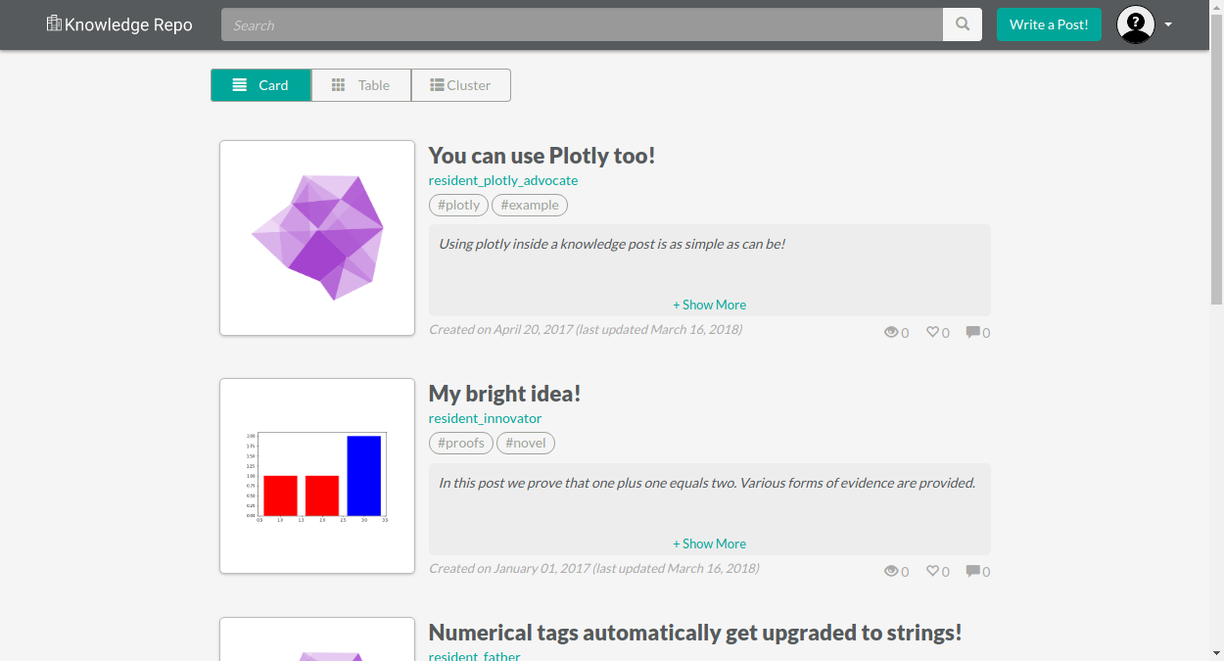
Knowledge Repo

Slide 29
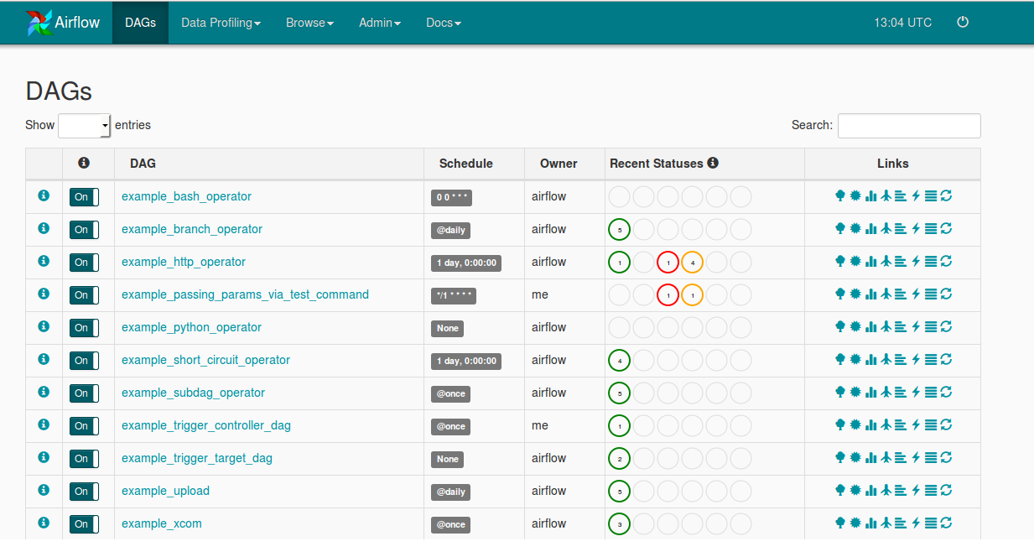
Example docker-compose.yml: Airflow
version: '3.3'
services:
redis:
build: other-builds/redis/
command: redis-server --bind 0.0.0.0
expose:
- "6379"
volumes:
- /var/run/docker.sock:/var/run/docker.sock
webserver:
build: .
depends_on:
- redis
ports:
- "5000:5000"
command: airflow webserver -p 5000
volumes:
- /var/run/docker.sock:/var/run/docker.sock
scheduler:
build: .
depends_on:
- webserver
command: airflow scheduler
volumes:
- /var/run/docker.sock:/var/run/docker.sock
worker:
build: .
depends_on:
- scheduler
command: airflow worker
volumes:
- /var/run/docker.sock:/var/run/docker.sock

Slide 30
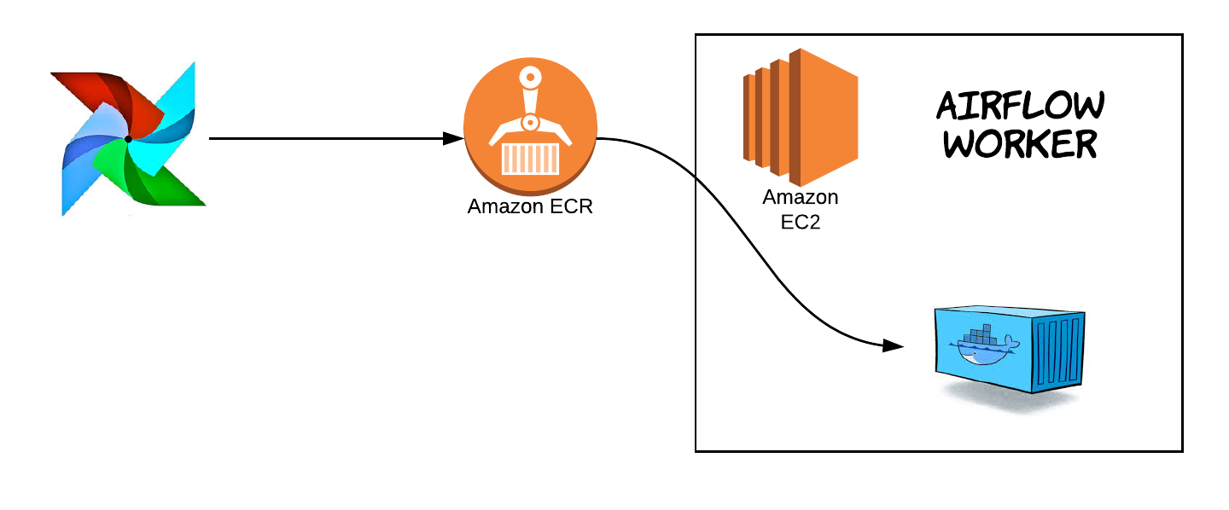
DockerOperator in Airflow

Slide 31
Questions?

